Slide 1
Factory Design Pattern

Slide 2
Background
If object creation code is spread in whole application, and if you need to change the process of object creation then you need to go in each and every place to make necessary changes.
This pattern introduces loose coupling between classes which is the most important principle one should consider and apply while designing the application architecture.
Loose coupling can be introduced in application architecture by programming against abstract entities rather than concrete implementations. This not only makes our architecture more flexible but also less fragile.

Slide 3
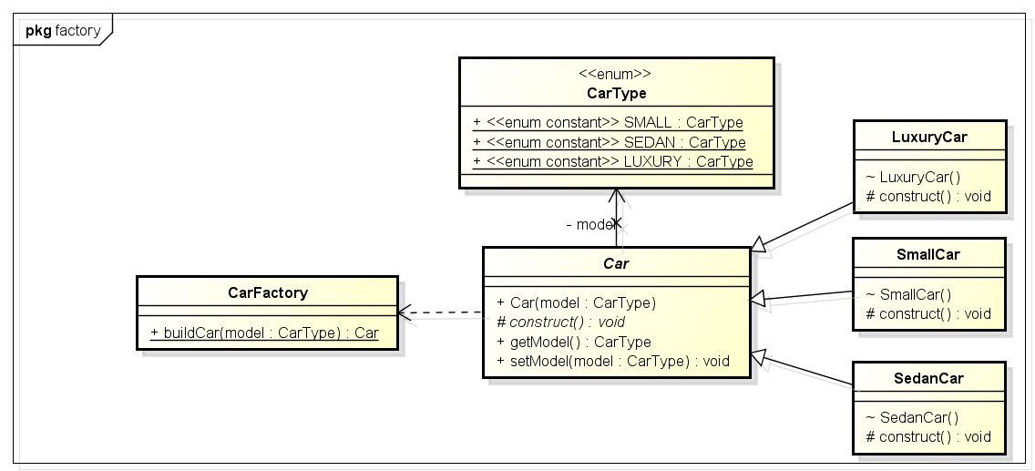
Diagram

Slide 4
Example : Car factory
A common scenario using example of car factory which is able to build 3 types of cars i.e. small, sedan and luxury.
Building a car requires many steps from allocating accessories to final makeup. [Add them as methods].
If we are unfortunate then we will create instances of car types (e.g. SmallCar) in our application classes and thus we will expose the car building logic to outside world and this is certainly not good. It also prevents us in making changes to car making process because code in not centralized, and making changes in all composing classes seems not feasible.

Slide 5
Implementation
Sample code
As you can see, factory is able to return any type of car instance it is requested for. It will help us in making any kind of changes in car making process without even touching the composing classes i.e. classes using CarFactory.
Approaches :
1) Either specified in an interface and implemented by child classes.
2) Implemented in a base class and optionally overridden by derived classes.

Slide 6
Advantages
The creation of an object precludes its reuse without significant duplication of code.
The creation of an object requires access to information or resources that should not be contained within the composing class.
The lifetime management of the generated objects must be centralized to ensure a consistent behaviour within the application.

Slide 7
Thank you

